Slide 1
Diabetic Therapeutic Shoes
Rules

Slide 2


Slide 3
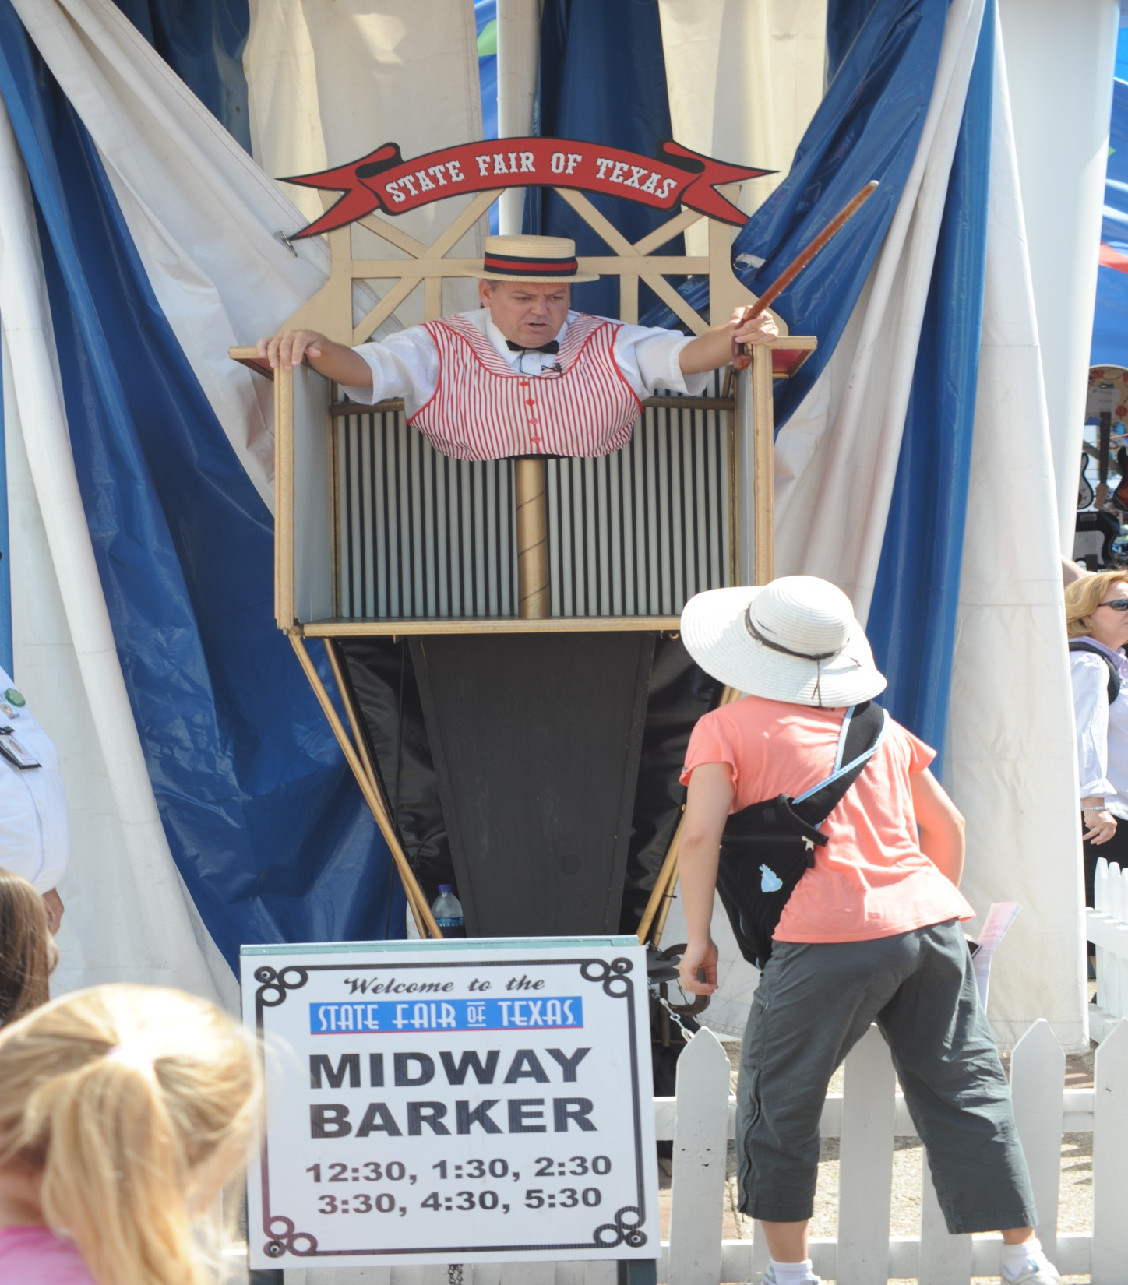

Slide 4


Slide 5


Slide 6
Pre-Payment Audits
The ability to perform a pre-payment review is part of the DMAC rules
Is this a problem for podiatrists?
  Previous post payment reviews for diabetic therapeutic shoes has shown almost a 100% non-compliance rate for all supplies
  The correct paperwork was not present

Slide 7
Pre-Payment Audits
CPEDS / Orthotists sometimes get any MD / DO to sign the certification
  undermines the integrity of the program
  plan-of-care problems
Better for podiatrists?
  if the correct paperwork is present
  if letters have been written
  If the treating MD/DO has proper records in their charts
  If the supplier (podiatrist) has proper records in their charts

Slide 8
What Should You Do?
Write a letter to the attending MD/DO outlining your findings ̶ Comprehensive Diabetic Foot Exam
  this gives the MD/DO the foot findings that becomes part of their medical records
  have them write back to you (or use a form you send them) telling you of the patient’s foot findings (they can get that info from your form)
  be sure MD/DO signs the certification form and CFDE they send back to you
  Have the specific wording on the bottom of your CDFE

Slide 9
Rules for Physician Managing DM
A detailed written order. Can be prepared by the supplier but must be signed and dated by MD/DO to indicate agreement.
A copy of an office visit note from MD/DO medical records that shows that you are managing the patient’s diabetes. This note should be within 6 months prior to delivery of the shoes and inserts.
Either
  A copy of an office visit note from your medical records that describes one of the qualifying conditions ; or
  An office visit note from another physician (e.g., podiatrist) or from a PA, NP, or CNS that describes one of the qualifying conditions.

Slide 10
Rules for Physician Managing DM
If second option is used, MD/DO must sign, date, and make a note on that document indicating your agreement and send that to the supplier. The note documenting the qualifying condition(s) must be more detailed than the general descriptions that are listed above. It must describe (examples not all-inclusive):
  The specific foot deformity (e.g., bunion, hammer toe, etc.); or
  The location of a foot ulcer or callus or a history of one these conditions; or
  The type of foot amputation; or
  Symptoms, signs, or tests supporting a diagnosis of peripheral neuropathy plus the presence of a callus; or
  The specifics about poor circulation in the feet v e.g., a diagnosis of venous or arterial insufficiency or symptoms, signs, or test documenting one of these diagnoses.

Slide 11
CDFE Wording
ATTENDING PHYSICIAN’S STATEMENT:
I agree with the findings as noted in the above diabetic foot exam and I stipulate that I am managing the patient’s diabetes mellitus under a comprehensive plan-of-care. This patient requires diabetic therapeutic shoes and insoles as part of that overall plan of care.
____________________________ ___________
Xxxx Yyyyyy, M.D. Date

Slide 12
Certification of MD/DO
New Certification every year
Cannot be filled-out by podiatrist
Becomes part of your medical records
You should send the MD/DO the certification form with the letter and CDFE you send them about the patient’s foot findings
This form is not sufficient by itself to show that the coverage criteria have been met, but must be supported by other documents in MD/DO medical records

Slide 13

Remember – You’re Both a Physician and a Supplier

Slide 14
Your Medical Records
Prescription / Order for diabetic therapeutic shoes and insoles
  Why does the patient need these shoes and insoles (therapeutic objectives)?
  Extra depth or custom-molded shoes?
  Multi-density insoles or custom fabricated?
  How many insoles will the patient get?
  How long will they need to use these DME items?
  Who will be supplying the shoes and insoles?
  What manufacturer, style and size shoe will you be ordering?
  Has a Certification for Shoes and insoles been received from the attending physician? Who?
  Copy of order

Slide 15
Your Medical Records
Dispensing Note diabetic therapeutic shoes and insoles
  Did you receive the Certification for the Diabetic Shoes and insoles from the attending physician?
  What is the name of that physician?
  What manufacturer, style and size shoe did you dispense?
  How many insoles did you dispense?
  What was the thickness, shore and durometer of the insoles?
  If the insoles were “heat molded,” how was that accomplished?
  Did you instruct the patient how to use the shoes and insoles?
  Did you provide them with a guarantee or warrantee?
  Did you provide the patient with Medicare’s 26 Supplier Standards?
  Did the patient sign a receipt?
  Invoice in your chart?

Slide 16
Questions

